Slide 1

.NET Core: Developing Cross-Platform Web Apps with ASP.NET Core – WorkshopPLUS
< Engineer Name >
Premier Field Engineer
v3.1

Slide 2
Active Directory, Azure, IntelliSense, Internet Explorer, Microsoft, Microsoft Corporate Logo, Silverlight, SharePoint, SQL Server, Visual Basic, Visual Studio, Windows, Windows Server, and Windows Vista are either registered trademarks or trademarks of Microsoft Corporation in the United States and/or other countries. Other Microsoft products mentioned herein may be either registered trademarks or trademarks of Microsoft Corporation in the United States and/or other countries. All other trademarks are property of their respective owners.

Slide 3
How to View This Presentation
To switch to Notes Page view:
On the ribbon, click the View tab, and then click Notes Page
To navigate through notes, use the Page Up and Page Down keys
Zoom in or zoom out, if required
In the Notes Page view, you can:
Read any supporting text—now or after the delivery
Add notes to your copy of the presentation, if required
Take the presentation files home with you
Notes:
Abbreviation list:

Slide 4
Module 1: Overview
Module Overview
Notes:
This module discusses the following sections:
Section 1: Design Patterns
Section 2: ASP.NET
Section 3: ASP.NET Core
After completing this module, you will be able to:
Understand the fundamental concepts of MVC design pattern.
Compare MVC with Web Forms and Web Pages
Understand how ASP.NET Core brings together all the three web development models.
Understand the major differences and enhancements made in ASP.NET Core.

Slide 5
Module 1: Overview
Section 1: Modern Web
Lesson: What is ASP.NET Core
Notes:
After completing this lesson, you will be able to:
Describe modern web
Learn about the attributes of modern web
Why should you learn this material?
To understand what modern web comprises of and how ASP.NET Core implements those attributes in its stack.

Slide 6
ASP.NET Core is an open-source and cross-platform framework for building modern cloud based internet connected applications, such as web apps, IoT apps and mobile backends.

Slide 7
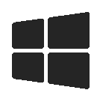

ASP.NET Core and the Modern Web
Totally Modular
Faster Development Cycle
Seamless transition from on-premises to cloud
Choose your Editors
and Tools
Open Source with Contributions
OSS
Cross-Platform
Fast
Notes:
Discuss here quickly what is a modern web application is look like and how it should be:
modular and pluggable and built on top of packages
How easy the deployment model should work between cloud and on-prem environments
How fast it receives updates through the framework development cycle
How it can be built and run on any platform (windows, macos and linux)
How fast it can run even faster then the previous platform.
How easy you can the editor of your choice
And how the open source community plays an important role on the product roadmap and changes

Slide 8
Demo: ASP.NET Core and Visual Studio 2019
Notes:
Show he a quick demo about asp.net core.
Create a new asp.net core web application and choose MVC or Razor (pick the one you like)
Show the aspects of the app quickly.

Slide 9
Module 1: Overview
Section 1: Modern Web
Lesson: One ASP.NET
Notes:
After completing this lesson, you will be able to:
Learn commonalities and various application models of One ASP.NET
Why should you learn this material?
To learn and understand that all application models share the same underlying common core.

Slide 10
History of ASP
1996 – Active Server Pages
2002 – ASP.NET
2008 – ASP.NET MVC
2010 – ASP.NET Web Pages
2012 – ASP.NET Web API, SignalR
2016 – ASP.NET Core 1.0 & .NET Core 1.0
2017 – ASP.NET Core 2.0 & .NET Core 2.0
2018 – ASP.NET Core 2.1, ASP.NET Core SignalR & .NET Core 2.1
2018 – ASP.NET Core 2.2 & .NET Core 2.2
2019 – ASP.NET Core 3.1 & .NET Core 3.1
Notes:
Tell here the history of asp and how it evolves

Slide 11
ASP.NET
Sites
Services
Web
Forms
Web
Pages
Single
Page
Apps
MVC
Web
API
SignalR
Web Hooks
ASP.NET
Notes:
Difference between SignalR and Webhooks:
SignalR is for notification within an ASP.NET app using WebSockets. You can exchange event notifications through WebSockets, however it requires a constant network connection.
Webhooks are for event notification across other web applications and other external services. (Think Business-to-Business (B2B) communication). For instance, you can receive a Webhook when someone sends you money to your PayPal account. PayPal fires off a POST request to your predefined URL handler and then your app does something with that notification. You pre-configure everything on the PayPal side first. You also set up an application to handle the incoming POST request. The event notification is "pushed" to you in (near) real-time. No need to hold open a network connection while waiting for events.

Slide 12
Commonalities
All programming models have the same Microsoft ASP.NET
Authentication/Authorization/Membership
Output Caching, Session State, and Configuration
AJAX, Deployment, etc.
All programming models are fully supported and will continue to be supported
All programming models solve real problems
Notes:
Despite their obvious differences, all programming models are based on the same ASP.NET core libraries that you are familiar with. Authentication, authorization, membership, caching, besides other areas are handled in exactly the same fashion across all ASP.NET programming models.

Slide 13
ASP.NET Core
Sites
Services
Razor Pages
Single
Page
Apps
MVC
Web
API
SignalR Core
gRPC
ASP.NET Core
Notes:
Difference between SignalR and Webhooks:
SignalR is for notification within an ASP.NET app using WebSockets. You can exchange event notifications through WebSockets, however it requires a constant network connection.

Slide 14
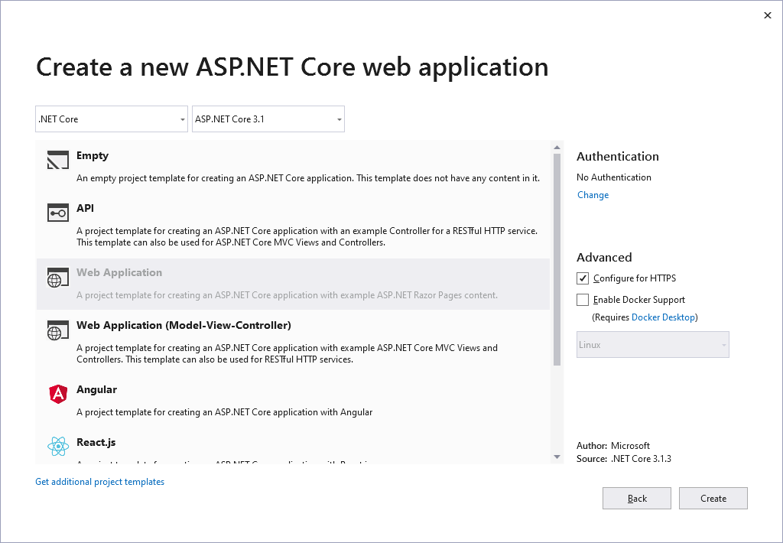
ASP.NET Core Project System
Notes:
New ASP.NET project template allows you to add supporting folders and references for any and all development models.

Slide 15
Demo: One ASP.NET
Notes:
Demo Script:
Create a new ASP.NET Core Web Application and Choose “Web Application (Mode-View-Controller)”
Run the application to make sure it is working fine.
Right click on the web project >> Add >> New Folder >> and name it “Pages”
Right click on Pages folder then add a new Razor Page and name it DemoPage
Run the app and show how MVC works side by side with Razor page and it’s add One ASP.NET
You can open the razor page by accessing it directly /DemoPage

Slide 16
Which One is Right for Me?
ASP.NET 4.x | ASP.NET Core
Build for Windows | Build for Windows, macOS, or Linux
Use Web Forms, SignalR, MVC, Web API, WebHooks, or Web Pages | Razor Pages is the recommended approach to create a Web UI as of ASP.NET Core 2.x. See also MVC, Web API, Blazor , gRPC, and SignalR.
One version per machine | Multiple versions per machine
Develop with Visual Studio using C#, VB, or F# | Develop with Visual Studio, Visual Studio for Mac, or Visual Studio Code using C# or F#
Good performance | Higher performance than ASP.NET 4.x
Use .NET Framework runtime | Use .NET Core runtime
https://docs.microsoft.com/en-us/aspnet/core/fundamentals/choose-aspnet-framework

Slide 17
ASP.NET 4.x vs. ASP.NET Core
MSBuild /CodeDOM > csc.exe
Compilation
.Net CLI (Roslyn)
Loose, GAC, NuGet
Libraries
NuGet
FCL, GAC, NuGet
Application Frameworks
NuGet
IIS
Web Server
IIS, HTTP.SYS, Kestrel
.NET BCL and FCL
Platform Libraries
.NET BCL and FCL; .NET on NuGet
.NET CLR
Runtime
.NET CLR; .NET Core CLR
IIS: WebEngine4.dll; EXE: OS
Runtime Loader
.Net CLI
Windows
Operating System
Windows, OSX, Linux

Slide 18
Module 1: Overview
Section 3: ASP.NET Core
Lesson: ASP.NET Core Projects
Notes:
After this lesson, you will be able to:
Understand ASP.NET Core project system
Understand support for various package managers
Understand the new configuration system
Why should you learn this material?
The information in this lesson is key to learning how to write ASP.NET applications effectively.

Slide 19
ASP.NET Core Project File
*.csproj
Simplified project file
Automatically includes all source files in/under the folder containing project.json
All project folder files shown in Solution Explorer
Visual Studio automatically monitors the ASP.NET Core project directory files

Slide 20
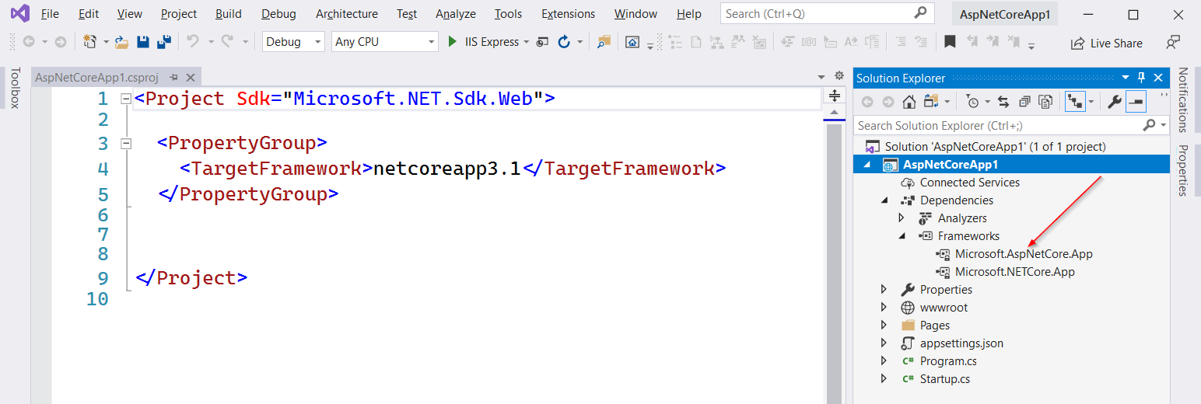
ASP.NET Core Project File Contents
Notes:
The default csproj is not very light weight.
The files and folders are included by default unless you want to exclude them, and this is the opposite behavior of the old csproj

Slide 21
ASP.NET Core Project File Explained
Although the .NET Core is built on top of NuGet packages, in .NET Core 3.x has its shared framework location
A shared framework provides a set of libraries at a central location so they can be used by different applications.
You don’t have to explicitly include the metapackage in the .csproj file
So what is the difference between: package, metapackage and framework?

Slide 22
Packages, Metapackages & Frameworks
Packages
.NET Core is split into a set of packages that provide primitives, higher-level data types, app composition types, and common utilities. Each of these packages represents a single assembly of the same name. For example, the System.Runtime package contains System.Runtime
Metapackage
A metapackage is a NuGet package convention for describing a set of packages that are meaningful together. A metapackage represents this set of packages by making them dependencies. The metapackage can optionally establish a framework for the set of packages by specifying a framework.
Framework
.NET Core packages each support a set of runtime frameworks. Frameworks describe an available API set (and potentially other characteristics) that you can rely on when you target a given framework. They are versioned as new APIs are added.
Notes:
More details: https://docs.microsoft.com/en-us/dotnet/core/packages

Slide 23
What is NuGet
NuGet is the package manager for .NET. The NuGet client tools provide the ability to produce and consume packages. The NuGet Gallery is the central package repository used by all package authors and consumers.
An essential tool for any modern development platform is a mechanism through which developers can create, share, and consume useful code. Often such code is bundled into "packages" that contain compiled code (as DLLs) along with other content needed in the projects that consume these packages.
Packages can be hosted on different sources
https://www.nuget.org – requires internet connection
Private source – can be online or offline
Notes:
Also very helpful is https://www.fuget.org/

Slide 24
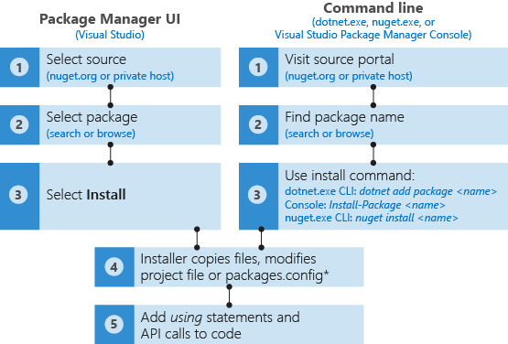
How to consume NuGet Packages

Slide 25
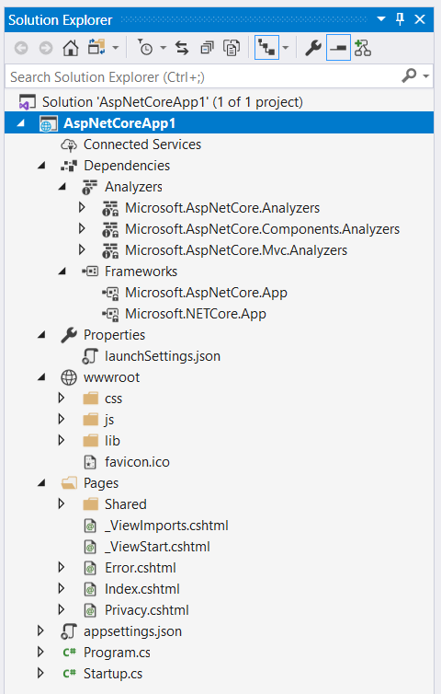
ASP.NET Core Project Layout
wwwroot folder
Static file placeholder
Dependencies
Analyzers
NuGet packages
No direct DLL references
Configuration through appsettings.json.
No web.config unless app is hosted in IIS or IIS Express

Slide 26
Module 1: Overview
Section 3: ASP.NET Core
Lesson: Configurations
Notes:
After this lesson, you will be able to:
Understand ASP.NET Core project system
Understand support for various package managers
Understand the new configuration system
Why should you learn this material?
The information in this lesson is key to learning how to write ASP.NET applications effectively.

Slide 27
Configuration files are completely pluggable The default JSON format can be replaced with an XML/.ini file or even take settings from a SQL Server database

Slide 28
ASP.NET Core Configuration Sources
App configuration in ASP.NET Core is based on key-value pairs established by configuration providers. Configuration providers read configuration data into key-value pairs from a variety of configuration sources:
Azure Key Vault
Command-line arguments
Custom providers (installed or created)
Directory files
Environment variables
In-memory .NET objects
Settings files
Notes:
More info can be found @ https://docs.microsoft.com/en-us/aspnet/core/fundamentals/configuration/

Slide 29
Generic Host Default Configuration
What's a host? A host is an object that encapsulates an app's resources, such as:
Dependency injection (DI)
Logging
Configuration
IHostedService implementations
Host configuration is provided from:
Environment variables prefixed with DOTNET_ (for example, DOTNET_ENVIRONMENT) using the Environment Variables Configuration Provider. The prefix (DOTNET_) is stripped when the configuration key-value pairs are loaded.
Command-line arguments using the Command-line Configuration Provider.

Slide 30
ASP.NET Core Web Host Default Configuration
Web Host default configuration is established (ConfigureWebHostDefaults):
Kestrel is used as the web server and configured using the app's configuration providers.
Add Host Filtering Middleware.
Add Forwarded Headers Middleware if the ASPNETCORE_FORWARDEDHEADERS_ENABLED environment variable is set to true.
Enable IIS integration.
App configuration is provided from:
appsettings.json using the File Configuration Provider.
appsettings.{Environment}.json using the File Configuration Provider.
Secret Manager when the app runs in the Development environment using the entry assembly.
Environment variables using the Environment Variables Configuration Provider.
Command-line arguments using the Command-line Configuration Provider.

Slide 31
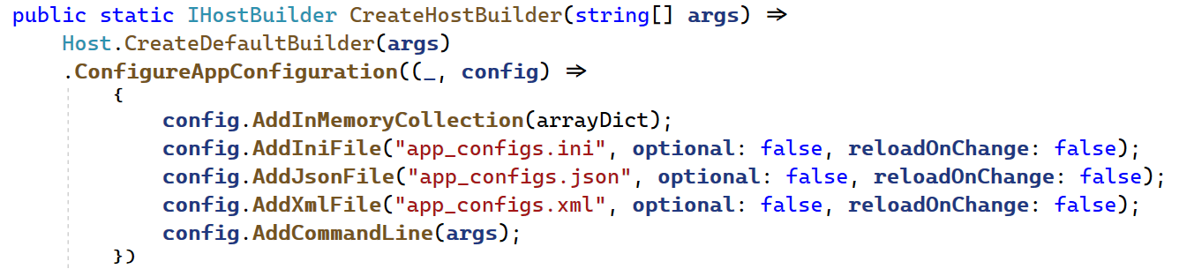
File Configuration Provider
INI Configuration Provider
JSON Configuration Provider
XML Configuration Provider
Order configuration providers in code to suit the priorities for the underlying configuration sources that the app requires.
The last provider in the order is to override its predecessor.

Slide 32
Demo:
ASP.NET Core Project and Configuration System
Notes:
Demo Script:
Explore new ASP.NET Core project and configuration system.
Show all config files in a starter template or any other ASP.NET Core app and show why we need various config files.
ConfigurationsDemo Demo
Open ConfigurationsDemo project in Module1 demo solution
Explorer how can we plug different types of configuration
The overriding value is the last loaded one in case of matched keys.

Slide 33
Module 1: Overview
Section 3: ASP.NET Core
Lesson: Middleware

Slide 34
Middleware
Middleware is software that's assembled into an app pipeline to handle requests and responses. Each component:
Chooses whether to pass the request to the next component in the pipeline.
Can perform work before and after the next component in the pipeline.
Integrated support by ASP.NET Core
Wired up in Configure method of Startup class
Either invokes the next component in chain or short-circuits it
Run, Map, and Use extension methods
MVC engine is configured in Request Pipeline through Use extension method
Implemented in-line as anonymous method, or through reusable class
Order of Use[Middleware] statements in application’s Configure method is very important
Notes:
Request delegates are used to build the request pipeline. The request delegates handle each HTTP request.
Request delegates are configured using Run, Map, and Use extension methods. An individual request delegate can be specified in-line as an anonymous method (called in-line middleware), or it can be defined in a reusable class. These reusable classes and in-line anonymous methods are middleware, also called middleware components. Each middleware component in the request pipeline is responsible for invoking the next component in the pipeline or short-circuiting the pipeline. When a middleware short-circuits, it's called a terminal middleware because it prevents further middleware from processing the request.

Slide 35
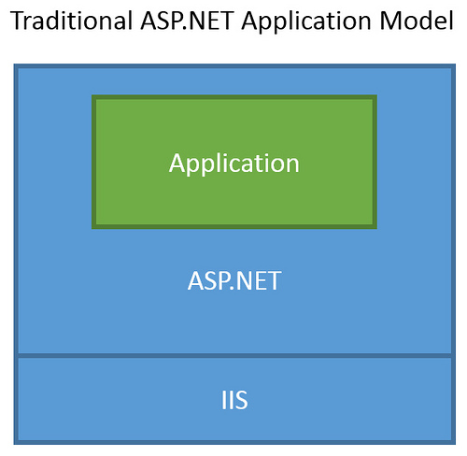
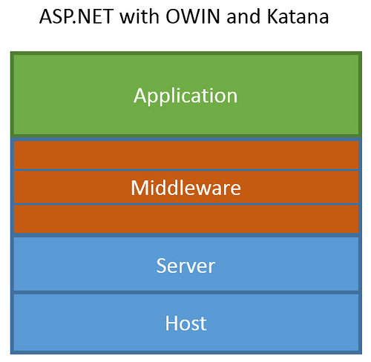
ASP.NET Core Middleware
Traditional ASP.NET Application Model
ASP.NET Core Middleware

Slide 36
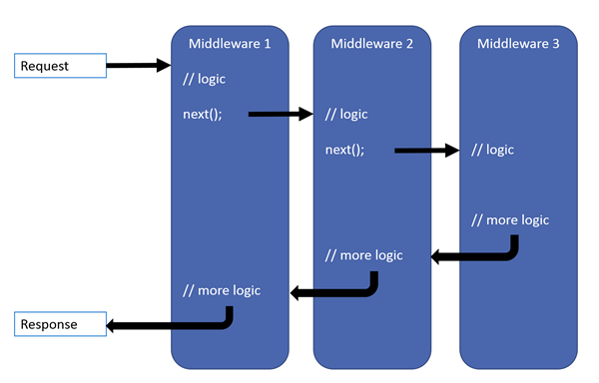
Middleware Pipeline
Notes:
The ASP.NET request pipeline consists of a sequence of request delegates, called one after the next, as the diagram in the slide section shows (the thread of execution follows the black arrows):
Each delegate has the opportunity to perform operations before and after the next delegate. Any delegate can choose to stop passing the request on to the next delegate, and instead handle the request itself. This is referred to as short-circuiting the request pipeline, and is desirable because it allows unnecessary work to be avoided. For example, an authorization middleware function might only call the next delegate in the pipeline if the request is authenticated, otherwise it could short-circuit the pipeline and simply return some form of “Not Authorized” response. Exception handling delegates need to be called early in the pipeline, so they are able to catch exceptions that occur in later calls within the call chain.

Slide 37
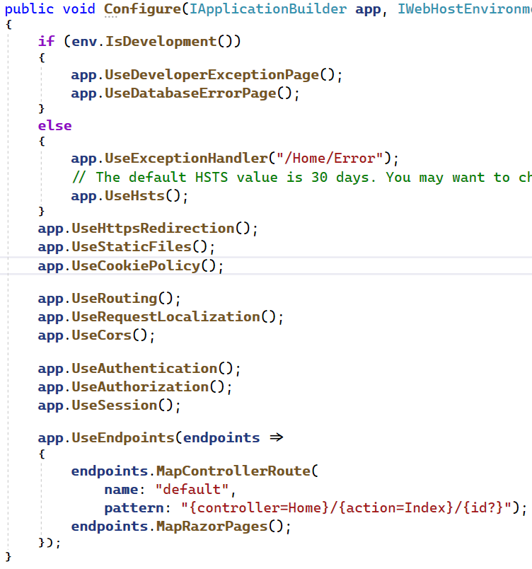
ASP.NET Core Pipeline Order
The order that middleware components are added in the Startup.Configure method defines the order in which the middleware components are invoked on requests and the reverse order for the response. The order is critical for security, performance, and functionality.
Exception/error handling
HTTP Strict Transport Security Protocol
HTTPS redirection
Static file server
Cookie policy enforcement
Authentication
Session
MVC
Razor
Notes:
More can be found here https://docs.microsoft.com/en-us/aspnet/core/fundamentals/middleware/

Slide 38
Demo: Writing Middleware
Notes:
Demo Script:
Open MiddlewareDemo solution in Visual Studio.
Uncomment in-line anonymous middleware in Startup.cs, and run the application.
You chain multiple request delegates together making a different call, with a next parameter representing the next delegate in the pipeline. Note that just because you are calling it “next” does not mean you cannot perform the actions both before and after the next delegate, as this example demonstrates:
Comment the anonymous middleware.
Uncomment reusable middleware call. Run the application using Web command and show how log messages show from middleware in the console window.
Go through RequestLoggerMiddleware.cs and RequestLoggerExtension.cs and show how the middleware is implemented.
Other demos are optional. You need to create a new asp.net core web application and apply the script below.
Demo 2:
Order of middleware is important.
app.UseStaticFiles();
app.UseResponseCompression();
Demo 3:
Also, demo the following extension methods of Static middleware:
app.UseStaticFiles();
app.UseDirectoryBrowser("/css");
app.UseFileServer(enableDirectoryBrowsing: true);
app.UseWelcomePage();
Demo 4:
Exception handling middleware
Show developer exception page
Show custom exception page.
Example of calling custom logger, sending an SMS, or anything else from the custom logging provider.

Slide 39
Module 1: Overview
Section 3: ASP.NET Core
Lesson: Hosting Servers
Notes:
After completing this lesson, you will be able to:
Learn how ASP.NET Core hosting works
Learn about various hosting options available for ASP.NET Core applications
Why should you learn this material?
Hosting is an important area for any web application. With ASP.NET 4 or earlier versions, IIS remained the only option. ASP.NET Core enables choice when it comes to hosting aspect of ASP.NET Core apps. This lesson dives into hosting features implemented by various hosting options and helps you make a right decision by comparing them.

Slide 40
ASP.NET Core Hosting
ASP.NET Core is completely decoupled from the web server environment that hosts the application
ASP.NET Core ships with the following server implementations:
Kestrel is the default, cross-platform HTTP server for ASP.NET Core and the default web server specified by the ASP.NET Core project templates.
HTTP.sys is only runs on Windows. HTTP.sys is an alternative to Kestrel server and offers some features that Kestrel doesn't provide. It is formerly called WebListener.

Slide 41
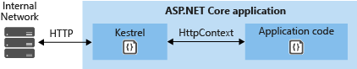
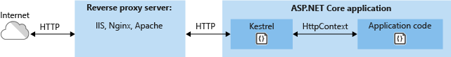
Kestrel
Kestrel is the default web server included in ASP.NET Core project templates.
Kestrel can be used by itself or with a reverse proxy server, such as IIS, Nginx, or Apache. A reverse proxy server receives HTTP requests from the Internet and forwards them to Kestrel after some preliminary handling.
Notes:
If your application accepts requests only from an internal network, you can use Kestrel by itself.
If you expose your application to the Internet, you must use IIS, Nginx, or Apache as a reverse proxy server. A reverse proxy server receives HTTP requests from the Internet and forwards them to Kestrel after some preliminary handling.
A reverse proxy is required for edge deployments (exposed to traffic from the Internet) for security reasons. Kestrel is relatively new and does not yet have a full complement of defenses against attacks. This includes but isn't limited to appropriate timeouts, size limits, and concurrent connection limits.+
Another scenario that requires a reverse proxy is when you have multiple applications that share the same port running on a single server. That doesn't work with Kestrel directly because Kestrel doesn't support sharing a port between multiple processes. When you configure Kestrel to listen on a port, it handles all traffic for that port regardless of host header. A reverse proxy that can share ports must then forward to Kestrel on a unique port.

Slide 42
Kestrel Features
Supported Features
HTTPS
Opaque upgrade used to enable WebSockets
Unix sockets for high performance behind Nginx
HTTP/2 (except on macOS†)
Operating system†
Windows Server 2016/Windows 10 or later‡
Linux with OpenSSL 1.0.2 or later (for example, Ubuntu 16.04 or later)
Target framework: .NET Core 2.2 or later
Application-Layer Protocol Negotiation (ALPN) connection
TLS 1.2 or later connection
Unsupported Features
Sharing an IP address and port across multiple instances without a reverse proxy.
SSL when configuring URL bindings using UseUrls
Notes:
HTTP/2 will be supported on macOS in a future release.
‡Kestrel has limited support for HTTP/2 on Windows Server 2012 R2 and Windows 8.1.
HTTP/2 is disabled by default. For more information on configuration, see the Kestrel options and ListenOptions.Protocols sections.

Slide 43
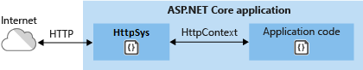
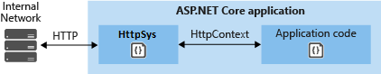
HTTP.sys
Supported Features
Windows Authentication
Port sharing
HTTPS with SNI
HTTP/2 over TLS (Windows 10)
Direct file transmission
Response caching
WebSockets (Windows 8 or later)
HTTP.sys is incompatible with the ASP.NET Core Module and can't be used with IIS or IIS Express.
Notes:
Because it's built on Http.Sys, WebListener doesn't require a reverse proxy server for protection against attacks. Http.Sys is mature technology that protects against many kinds of attacks and provides the robustness, security, and scalability of a full-featured web server. IIS itself runs as an HTTP listener on top of Http.Sys.
Enable Windows Authentication with IIS and Kertrel or Enable Windows Authentication with HTTP.sys => https://docs.microsoft.com/en-us/aspnet/core/security/authentication/windowsauth?view=aspnetcore-2.1

Slide 44
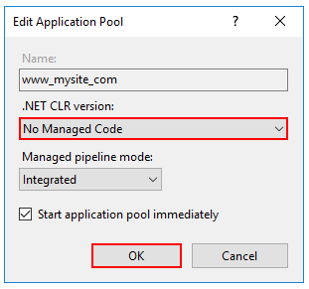
Internet Information Services (IIS)
IIS is used as reverse proxy with Kestrel
HTTP.sys cannot be used with IIS in a reverse proxy configuration
To host ASP.NET Core app on IIS you need to install .NET Core Hosting Bundle (Installed by default when you install .NET Core SDK)
For a better performance, Application Pool configuration for the website needs to run with No Managed Code
IIS relied on ANCM (ASP.NET Core Module) to run the apps.

Slide 45
ASP.NET Core Module
The ASP.NET Core Module is a native IIS module that plugs into the IIS pipeline to either:
In-process hosting model
Host an ASP.NET Core app inside of the IIS worker process (w3wp.exe)
Out-of-process hosting model
Forward web requests to a backend ASP.NET Core app running the Kestrel server.

Slide 46
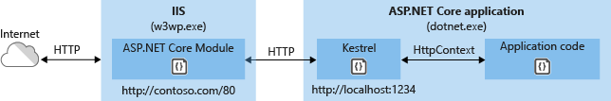
In-process hosting model
ASP.NET Core apps default to the in-process hosting model.
Request flow
Incoming web request is routed to primary port 80/443 through kernel model Http.Sys driver
Request forwarded to ASP.NET Core app (on non-80-443 port)
Kestrel picks up the request and pushes it into ASP.NET Core middleware pipeline
Middleware passes the request to application logic as HTTPContext instance
Application HTTP response is eventually passed back to IIS

Slide 47
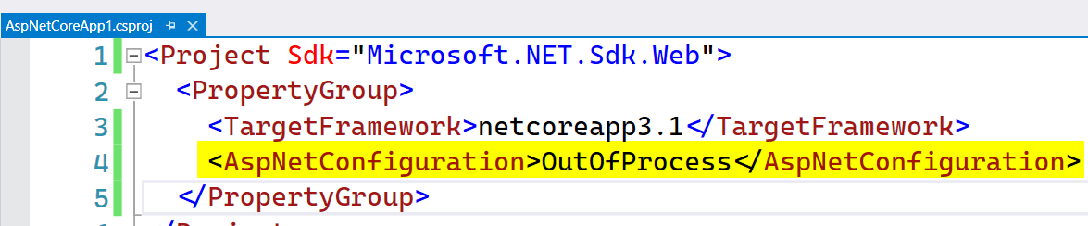
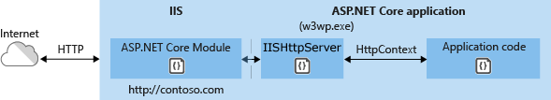
Out-of-process hosting model
To configure an app for out-of-process hosting, set the value of the <AspNetCoreHostingModel> property to OutOfProcess in the project file (.csproj):
Request flow
Loads the CoreCLR.
Calls Program.Main.

Slide 48
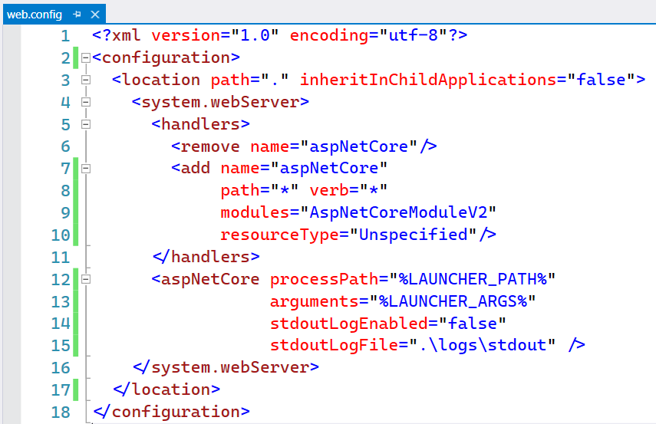
Enable ANCM in web.config
You can create the needed web.config file by executing the following command (CLI)
dotnet new webconfig
The configuration will enable the ASP.NET Core Module to be executed in the IIS request pipelines

Slide 49
Which Web Server Should You Use?
Notes:
Recommendation: If you intend to deploy your application on a Windows server, you should run IIS as a reverse proxy server that manages and proxies requests to Kestrel. If deploying on Linux, you should run a comparable reverse proxy server such as Apache or Nginx to proxy requests to Kestrel.
Ref: https://docs.asp.net/en/latest/fundamentals/servers.html

Slide 50

Choosing Web Servers
 | Windows | Linux/OSX | Development-Ready
IIS
IIS Express
HTTP.sys
Kestrel
Apache/Nginx
Notes:
If you intend to deploy your application on a Windows server, you should prefer the Windows optimized servers (IIS and WebListener). IIS remains the best choice for typical web application deployments on Windows servers, and provides the richest set of features. Choose WebListener instead of IIS only if you need to host your application within your own process or service. Use Kestrel if you intend to develop or deploy to non-Windows environments.
The recommended way to run ASP.NET Core applications on Windows is using IIS as a reverse-proxy server. The HttpPlatformHandler module in IIS manages and proxies requests to an HTTP server hosted out-of-process. ASP.NET Core ships with two different HTTP servers:
Microsoft.AspNetCore.Server.Kestrel (AKA Kestrel, cross-platform)
Microsoft.AspNetCore.Server.WebListener (AKA WebListener, Windows-only, preview)
ASP.NET Core does not directly listen for requests, but instead relies on the HTTP server implementation to surface the request to the application as a set of feature interfaces composed into an HttpContext. While WebListener is Windows-only, Kestrel is designed to run cross-platform.
Custom Server: You can create your own server in which to host ASP.NET apps, or use other open source servers. When implementing your own server, you’re free to implement just the feature interfaces your application needs, though at a minimum you must support IHttpRequestFeature and IHttpResponseFeature.

Slide 51
Demo: Kestrel & HTTP.sys hosting
Notes:
Demo Script:
Open HostingServersDemo project in Module1 demo solution
Show how to configure HTTP.sys
Show how Kestrel is configured by default in CreateWebHostBuilder method
Run the application from the command prompt by executing: dotnet run
Open any page then show how Kestrel is loaded by default.
Now run the app with --EnableHttpSys switch: dotnet run --EnableHttpSys
Open any page then show how HTTP.sys is loaded from the console loggins: Microsoft.AspNetCore.Server.HttpSys.HttpSysListener

Slide 52
Demo: IIS Hosting
Notes:
Demo Script:
Use the previous example then publish the web application to a folder using VS or using the CLI: dotnet publish
Make sure that the app have a corresponding web.config which have the ANCM settings to run the app
If you don’t have just run: dotnet new webconfig
Create a new application pool with name HostingServersDemo and select “No Managed Code” in the .NET CLR version
Create a new web application with name HostingServersDemo and use the recently created app pool and select the correct publish folder and use any unused port in your machine.
Run the app and show how it work and how w3wp launces dotnet.exe
Demo Script Screenshot in the next hidden slide
Hosting:
IIS middleware
No managed code configuration for App Pool.

Slide 53
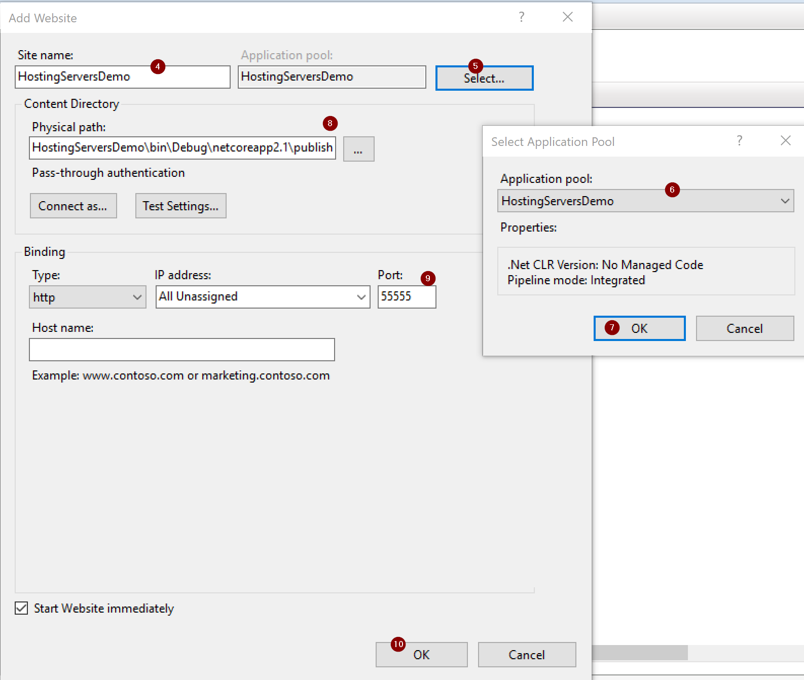
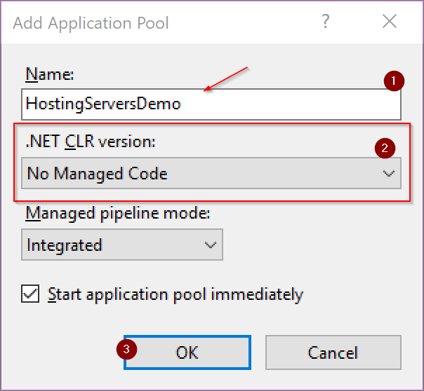
Publish to IIS

Slide 54
Module 1: Overview
Section 3: ASP.NET Core
Lesson: Working Environments
Notes:
After completing this lesson, you will be able to learn:
Working environments

Slide 55
Working Environments
Working Environments
Development
Test
Staging
Production
Startup Conventions
Startup ➔ Startup{EnvironmentName} – for example, StartupDevelopment
ConfigureServices( ) ➔ Configure[Environment]Services( )
Configure( ) ➔ Configure[Environment]( )
Applies to Microsoft Azure as well through App Settings in Azure Portal
Notes:
ASP.NET Core introduces improved support for controlling application behavior across multiple environments, such as development, staging, and production. Environment variables are used to indicate which environment the application is running in, allowing the app to be configured appropriately.
When an ASP.NET Core application starts, the Startup class is used to bootstrap the application, and load its configuration settings, etc. However, if a class exists, named Startup{EnvironmentName}, for example, StartupDevelopment, and the ASPNET_ENV environment variable matches that name, then that Startup class is used instead. Thus, you could configure Startup for development, but have a separate StartupProduction that would be used when the app is run in production or vice versa.
In addition to using an entirely separate Startup class based on the current environment, you can also make adjustments to how the application is configured within a Startup class. The Configure() and ConfigureServices() methods support environment-specific versions similar to the Startup class itself, of the form Configure[Environment]() and Configure[Environment]Services(). If you define a method ConfigureDevelopment(), it will be called instead of Configure() when the environment is set to development. Likewise, ConfigureDevelopmentServices() would be called instead of ConfigureServices() in the same environment.
ASP.NET Core provides a number of features and conventions that allow developers to easily control how their applications behave in different environments. When publishing an application from development to staging to production, environment variables set appropriately for the environment allowing for optimization of the application for debugging, testing, or production use, as appropriate.

Slide 56
ASP.NET Core Environments
ASP.NET Core configures app behavior based on the runtime environment using an environment variable.
ASP.NET Core reads the environment variable ASPNETCORE_ENVIRONMENT at app startup and stores the value in IWebHostEnvironment.EnvironmentName
ASPNETCORE_ENVIRONMENT can be set to any value, but three values are provided by the framework:
Development
Staging
Production (default)

Slide 57
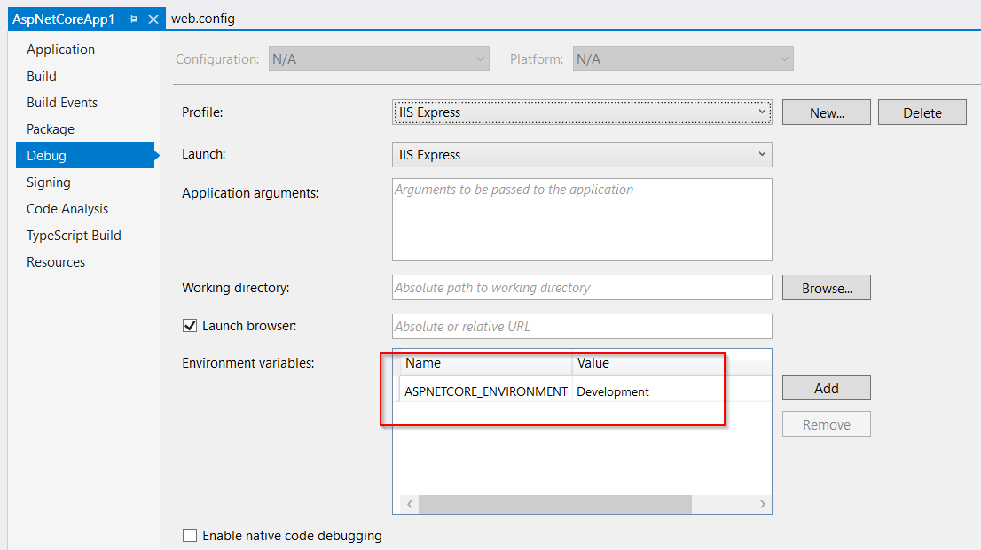
Setting Environment Configuration – Visual Studio

Slide 58
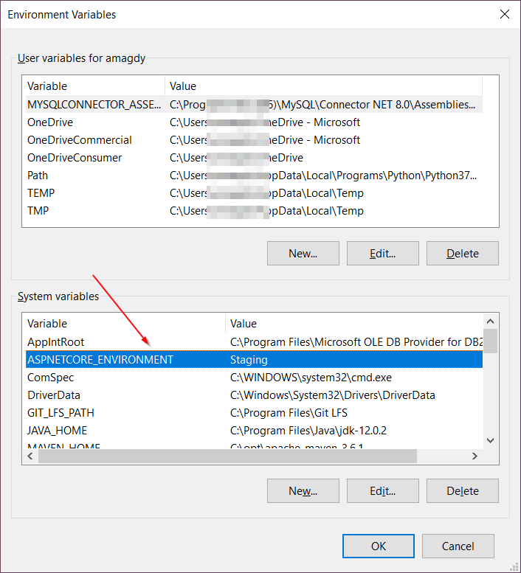
Setting Environment Configuration – Windows

Slide 59
Demo: Working Environments
Notes:
Demo Script:
Open the EnvironmentsDemo application in Demos folder.
Right-click the project and go to properties.
Go to Debug tab and set the Hosting environment property to Production.
Run the application. It should show a standard ASP.NET default template web app.
Go back to project properties and set the Hosting environment property to Development.
Re-run the application. It should show a beautiful welcome page.
Go back to project properties and set the Hosting environment property to Staging.
Re-run the application. It should show the following text: Staging Environment!.
Go to Startup.cs and show how it is set up for the three working environments with three startup classes.

Slide 60
Module Summary
In this module, you learned the following:
What is ASP.NET Core
One ASP.NET
ASP.NET Core Projects
ASP.NET Core Configurations
ASP.NET Core Middleware
ASP.NET Core Hosting Servers
Working Environments

Slide 61
Lab: Explore Visual Studio Tooling, ASP.NET Core

Slide 62
Connect to Lab environment LOD
Using your browser go to any of the following links:
https://aka.ms/premiereducation
https://aka.ms/lod
Sign in with your Microsoft account (Live ID/Azure Id)
If you do not have one, then create it here: http://live.com
Click “Redeem Training Key”
Register the lab code YOUR LAB Code
Notes:
Update the slide with your workshop code in red.

Slide 63
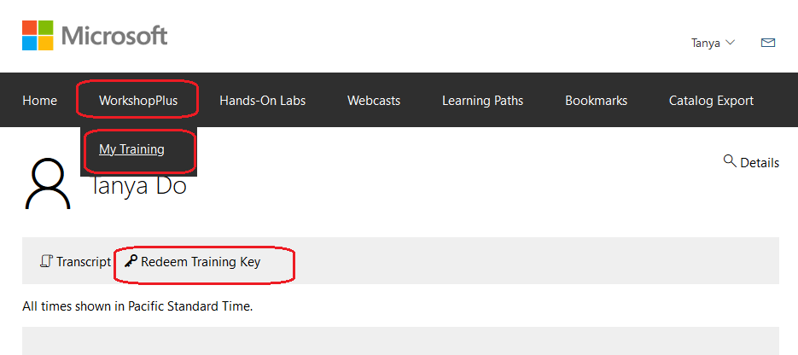
How to “redeem” the training key

Slide 64
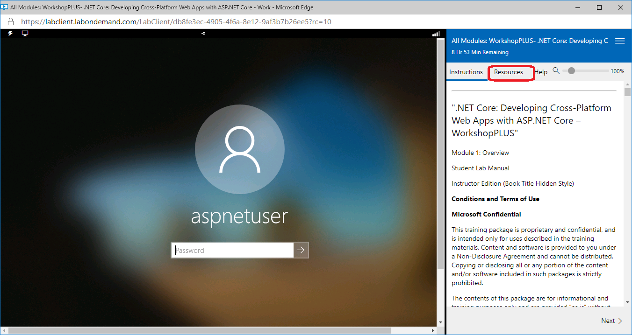
“Resource” tab for login password

Slide 65


